Slide 1
TELESTO
USER MANUAL

Slide 3
STARTUP

Slide 4
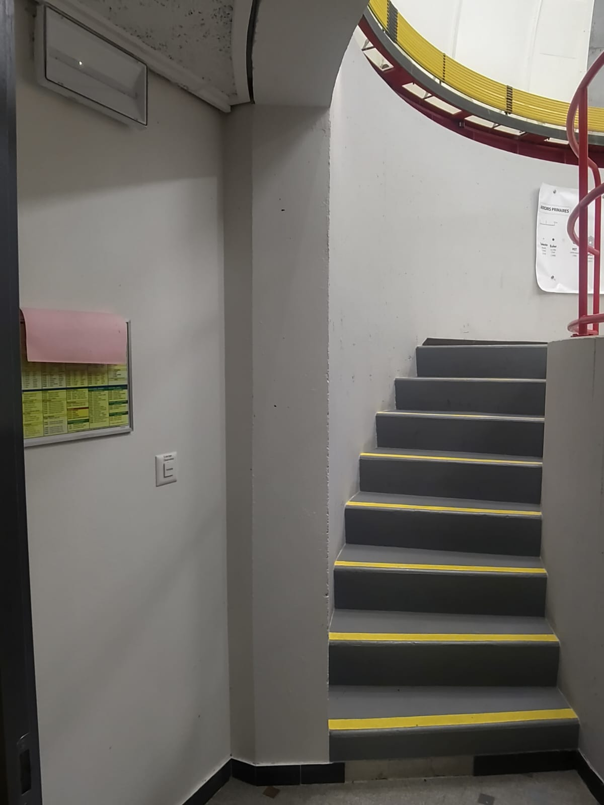
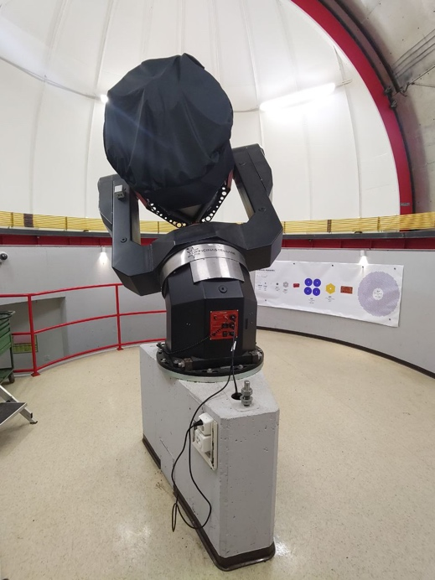
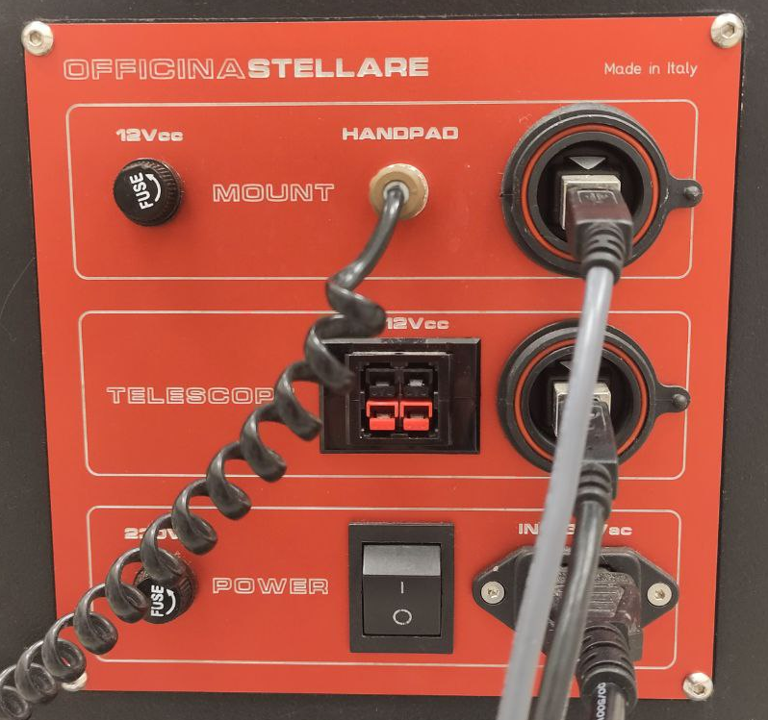
IN THE DOME
0. If it’s too dark, switch on the lights in the dome (at the left of the dome entrance)
1. Switch ON the telescope electricity by using the designated switch (1=ON, 0=OFF).
Press this button to switch on the lights in the dome

Slide 5
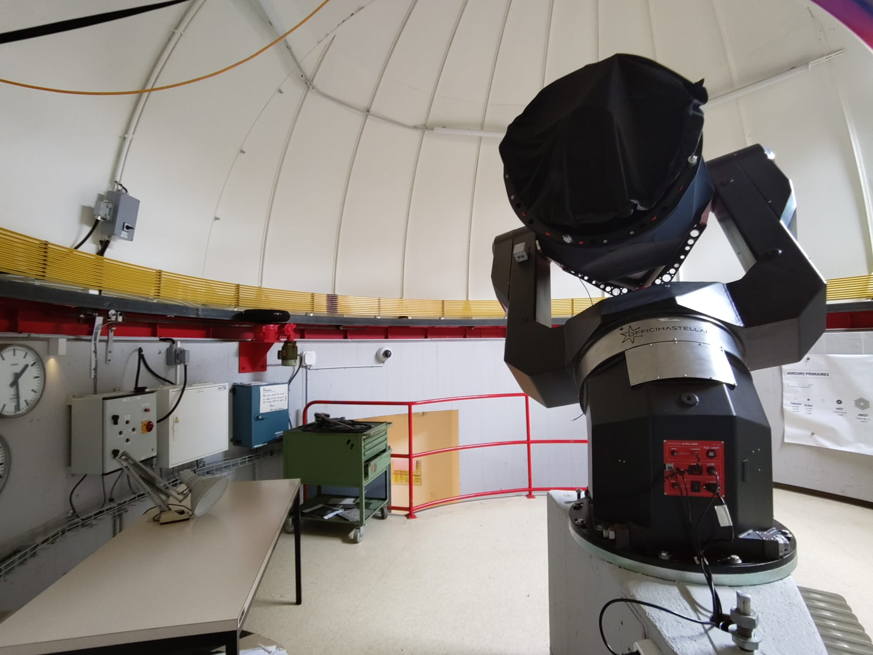
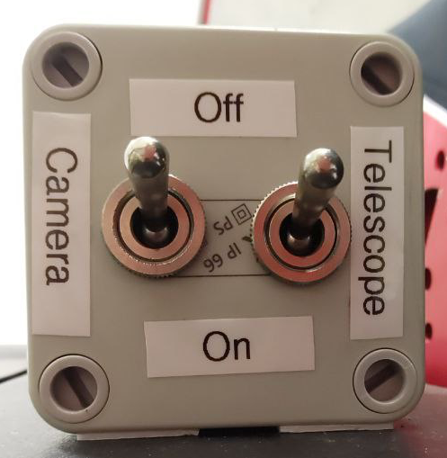
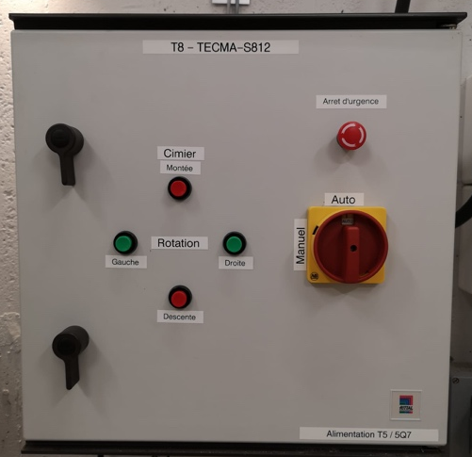
2. Turn on the Camera and the Telescope: pull down the two switches
3. Make sure that the dome is on ‘Auto’ and not manual. This allows to move the dome directly from the software in the control room.

Slide 6
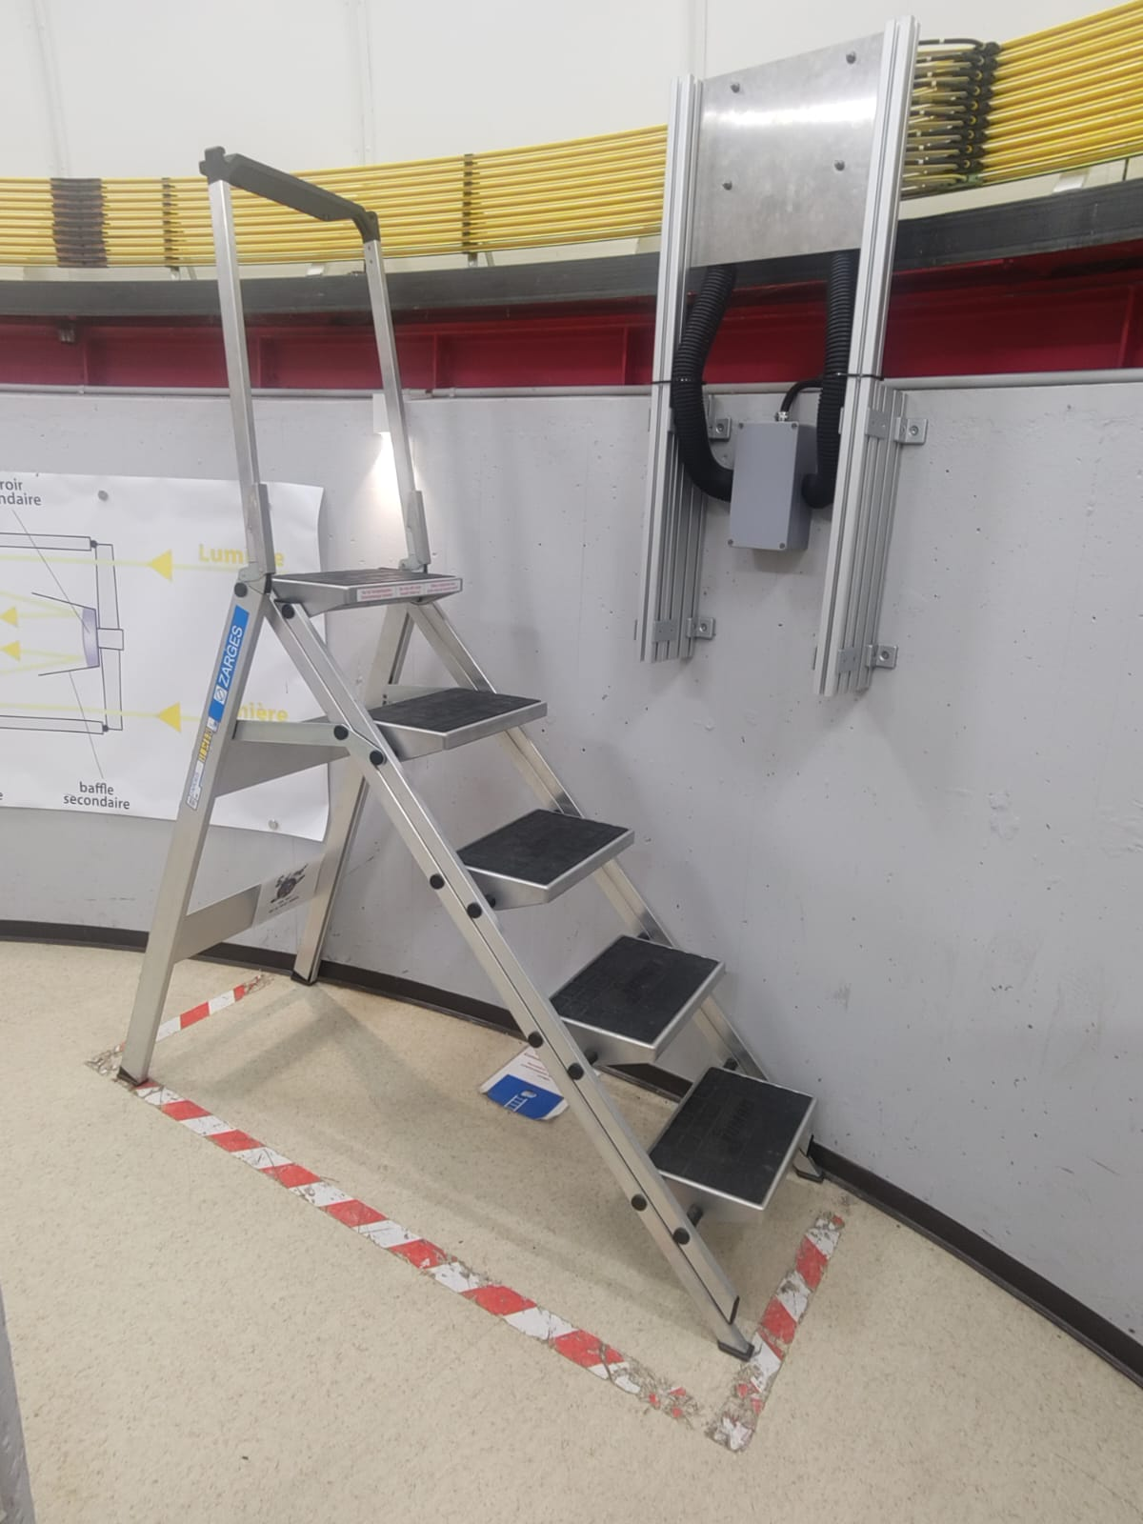
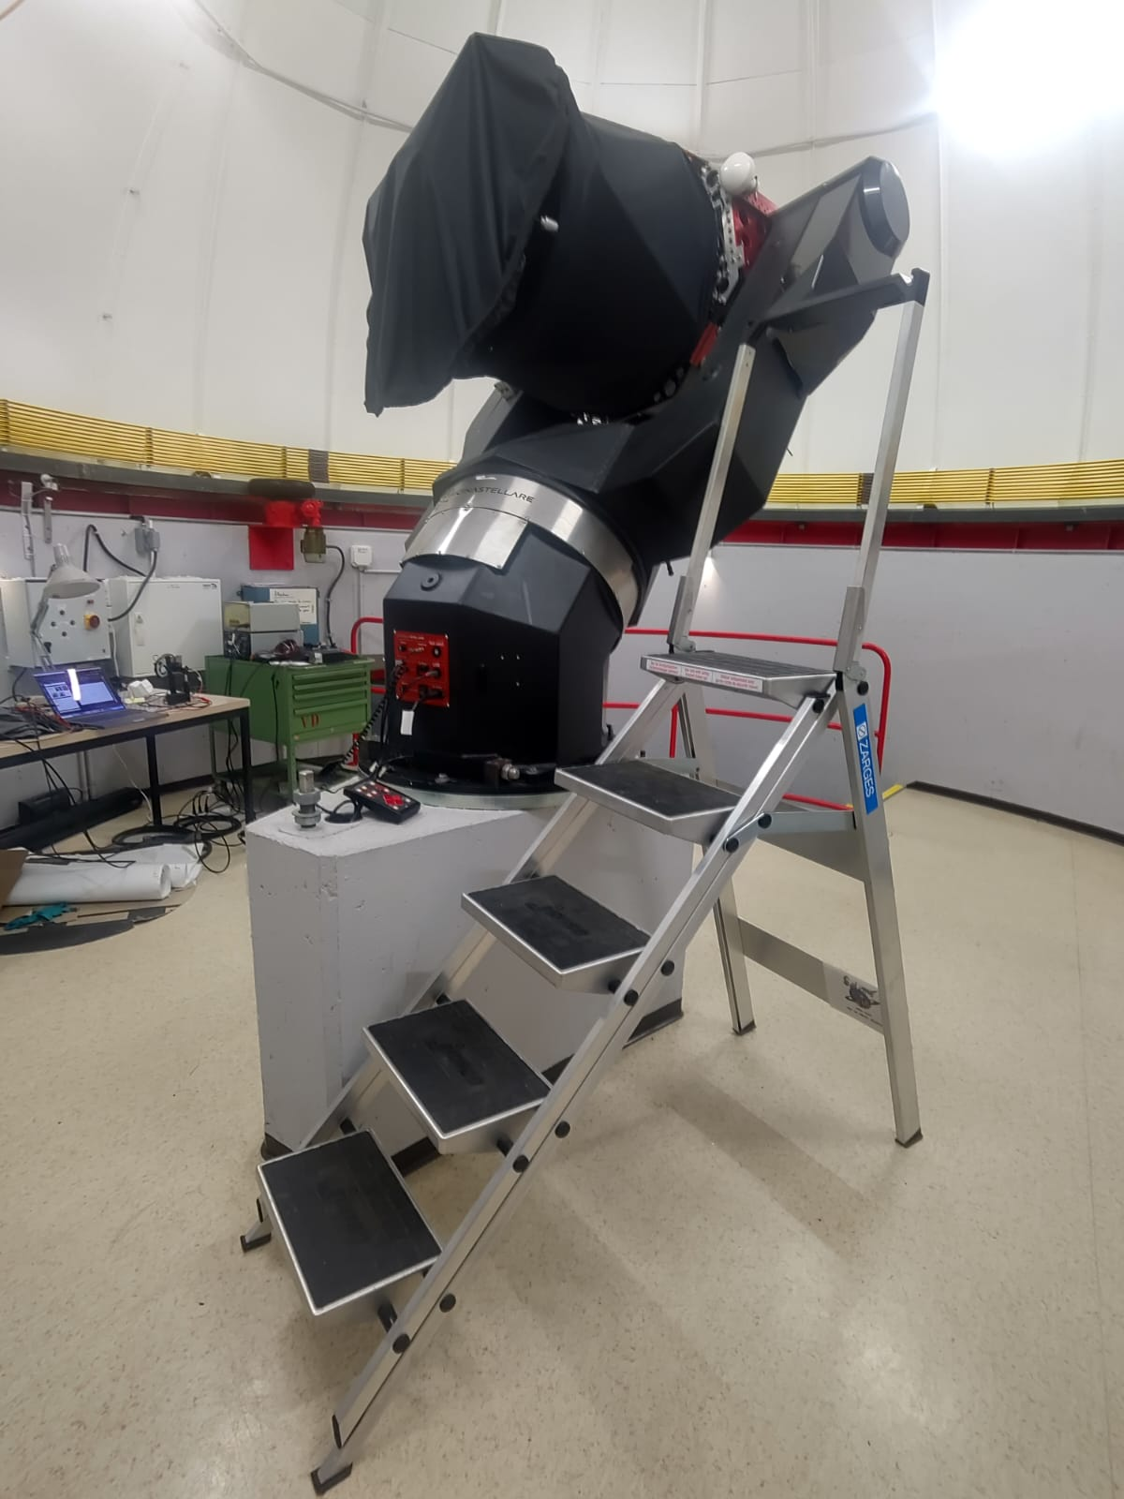
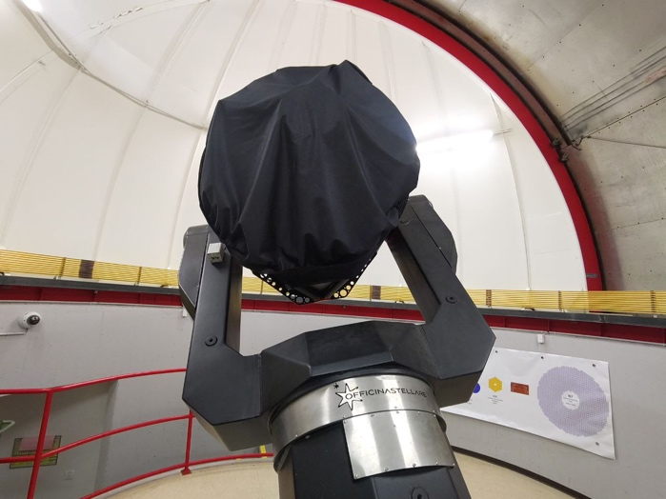
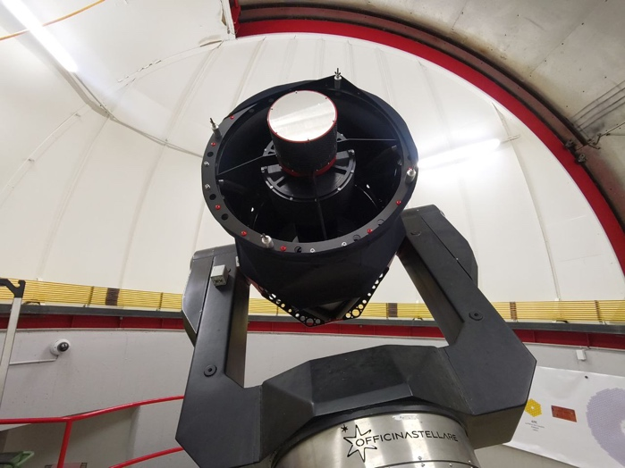
4. Use the ladder to help you remove the cover from the telescope
1. Take the ladder in the dome and place it close to the telescope
2. Remove the cover from the telescope
With cover
Without cover
5. Put back the ladder where it was, switch off the dome lights and close the door of the dome

Slide 7
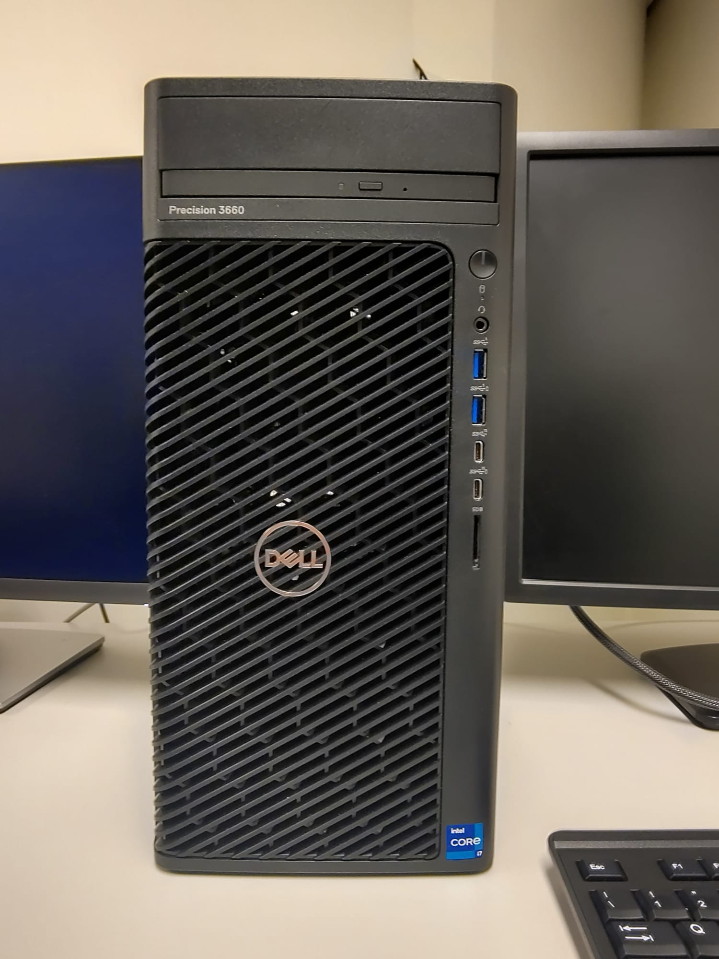
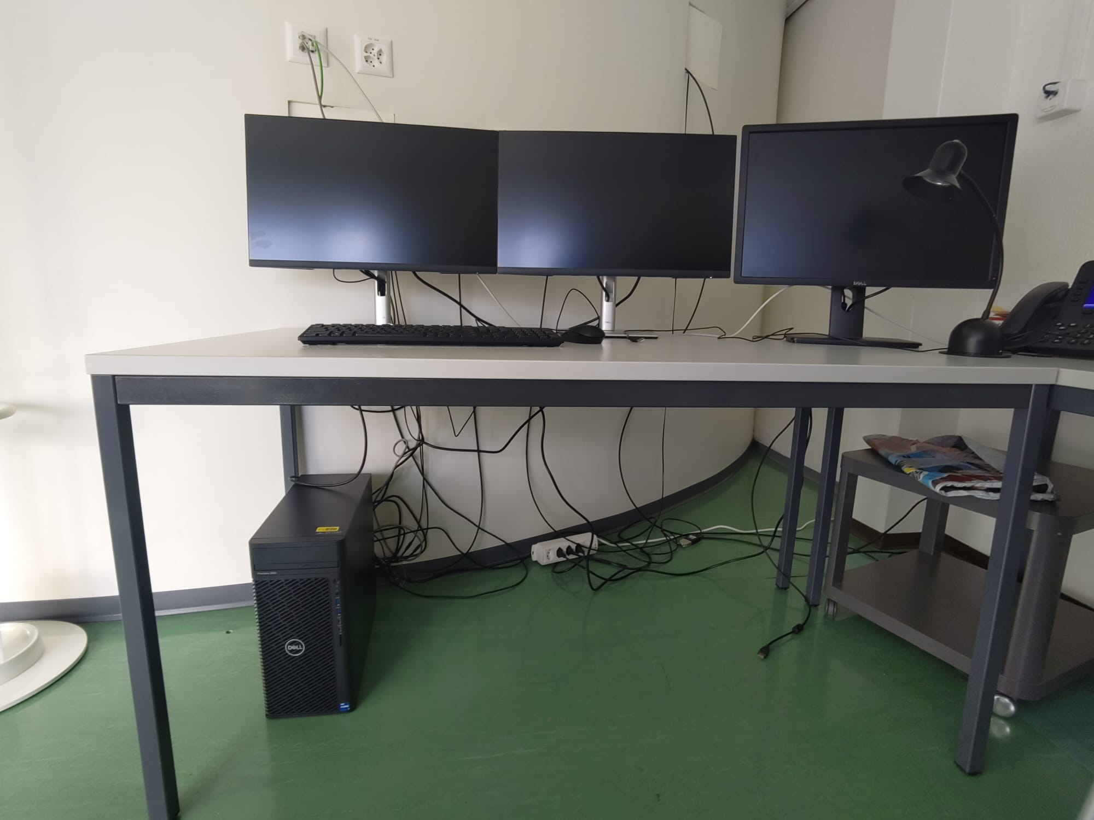
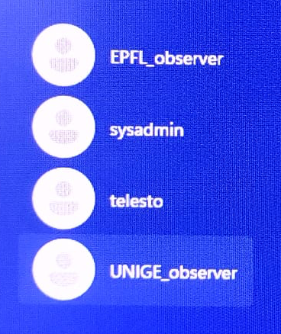
IN THE CONTROL ROOM
6. Turn on the big Dell computer
1. Press this button to switch on the computer
7. Select an observer account (either UNIGE or EPFL, depending on you) and log in. The password is:
- unige1559 for UNIGE_observer
- 1969epfl for EPFL_observer
With this account you can not install any software on the computer, so do not try It ☺

Slide 8
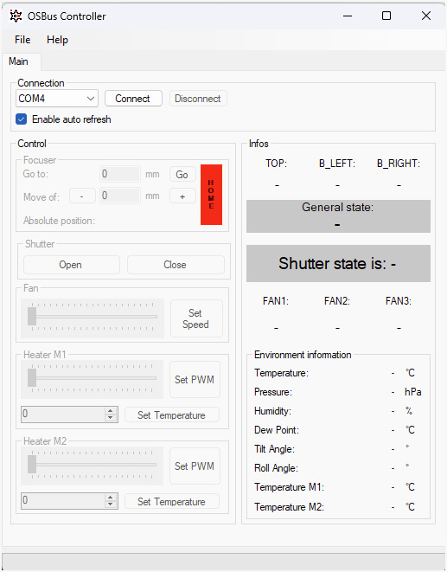
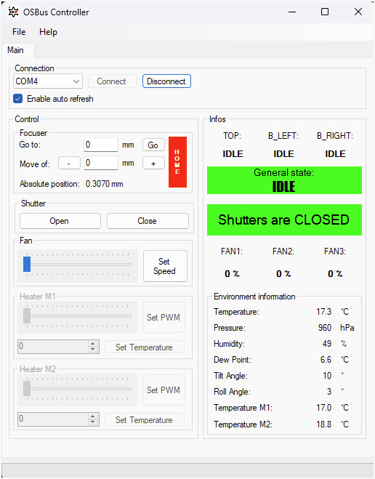
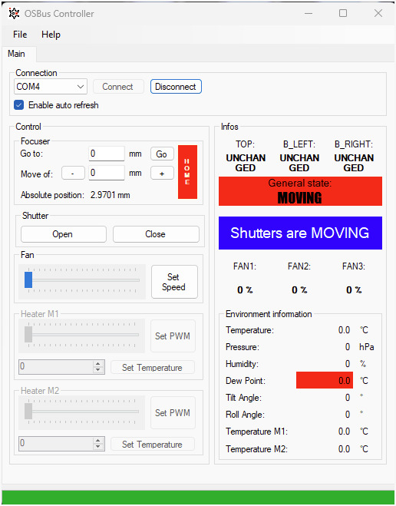
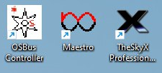
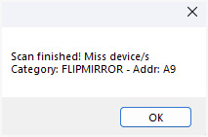
8. Launch the OSBUs Controller software and connect it
1. Open OSBus Controller program (on the top right of the Desktop)
2. Check that the connection is ‘COM4’
3. Click ‘Connect’
4. Wait
5. Click ‘OK’
6. All good

Slide 9
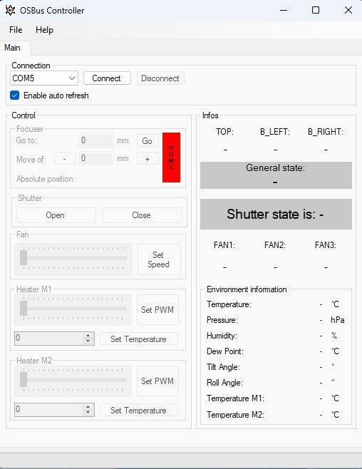
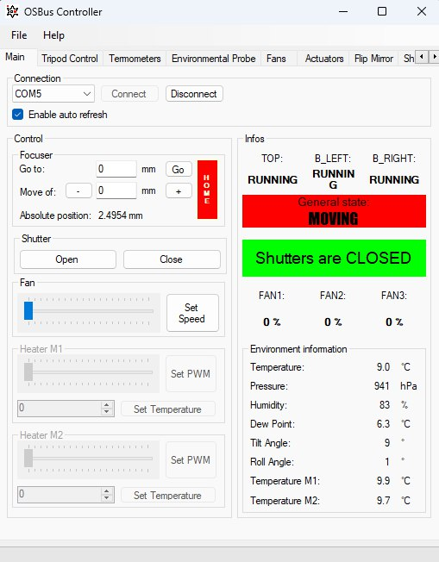

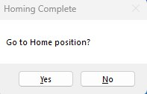
9. Click on “Home” to home the focuser and close OSBus
1. Click ‘HOME’
2. Wait
2. Wait
4. Everything is good!
5. Close OSBus
3. Click ‘Yes’

Slide 10
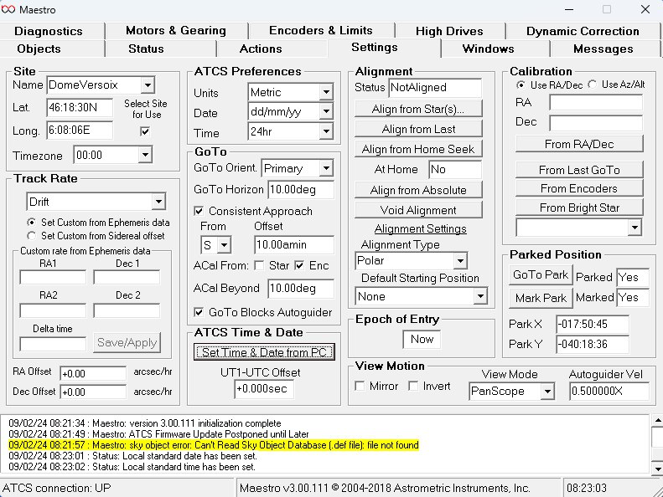
10. Open Maestro3. If a pop-up window appears and asks if you want to do an update of Maestro, simply click on “Later”.
11. Go in the ‘settings’ tab and wait one/two minutes so that the window shows all the values like in the picture (if they are slightly different it’s fine!)
IF THE PROGRAM IS STUCK, REOPEN IT
1. Click on the ‘settings’ tab
2. Verify that there are number values

Slide 11
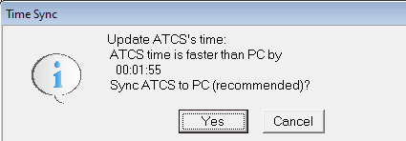
12. Click on “Set Time & Data form PC”
1. Click ‘Set Time & Date form PC
2. Click ‘Yes’
3. All good

Slide 12
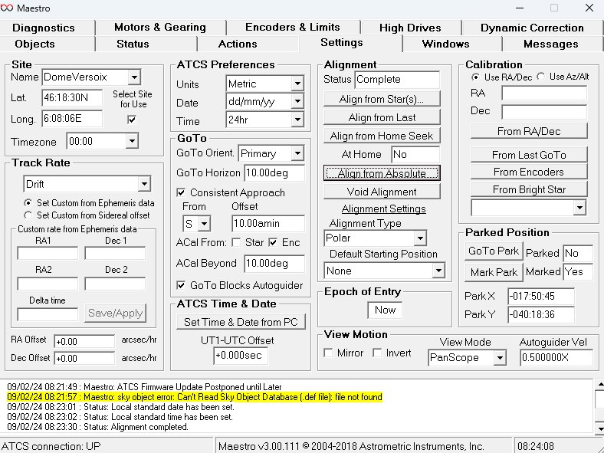
13. Click on “Align from absolute” (NEVER CLICK ON ‘Void Alignment’) and minimize Maestro (do not close it)
1. Click on ‘Align from Absolute’ (NOT ‘Void Alignment’)
2. All good
3. Minimize Maestro
NO! NEVER!

Slide 13
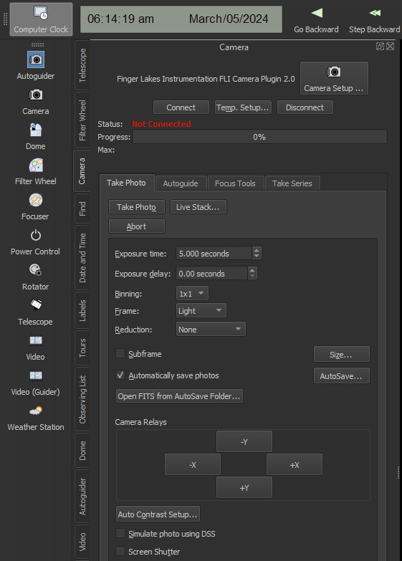
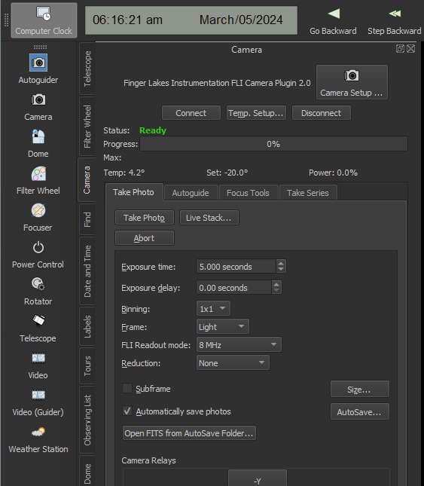
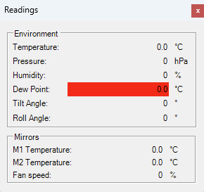
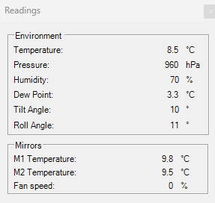
14. Open SkyX
15. Connect the camera (connect + disconnect + connect)
6. This new window appears. These are the physical values of the CCD.
1. Click on ‘Camera’
2. Click on ‘Connect’
3. A window like this should appear
4. Click on ‘Disconnect’
5. Click again on ‘Connect’
PLEASE, NEVER CHANGE THE DEVICE OR AUTO-SAVE CONFIGURATION IN SkyX!

Slide 14
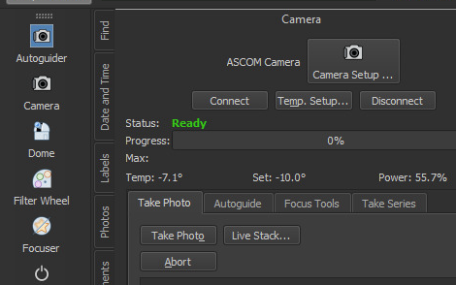
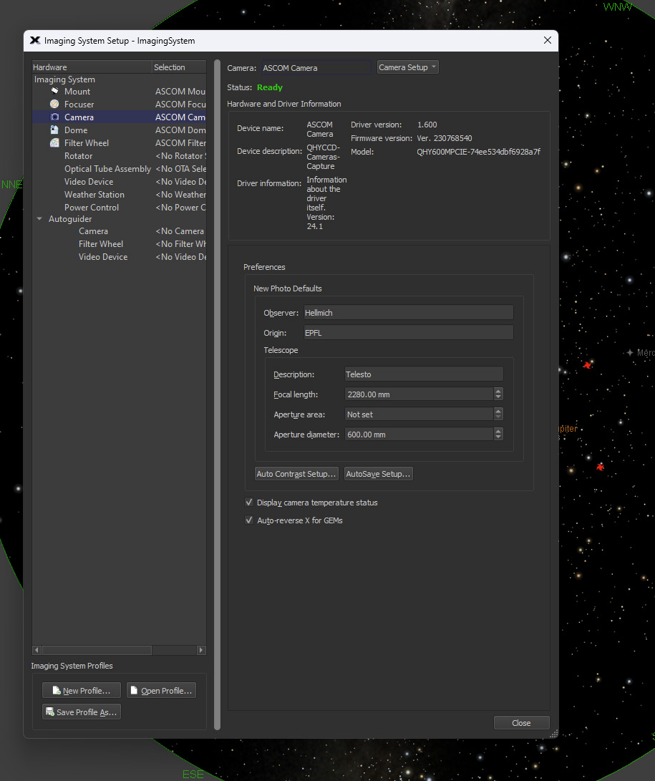
16. Enter your name as observer
1. You should already be in the ‘Camera’ section
2. Check the Status is ‘Ready’
3. Click on ‘Camera Setup …’
4. In the windows that pop ups, as observer insert your family name and as origin UNIGE or EPFL
5. Click on ‘close’

Slide 15
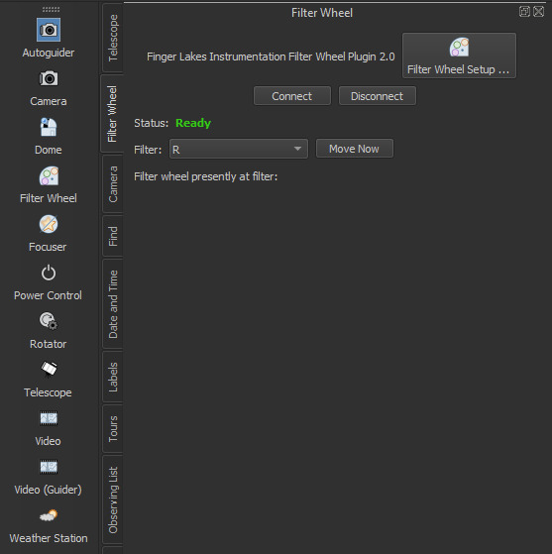
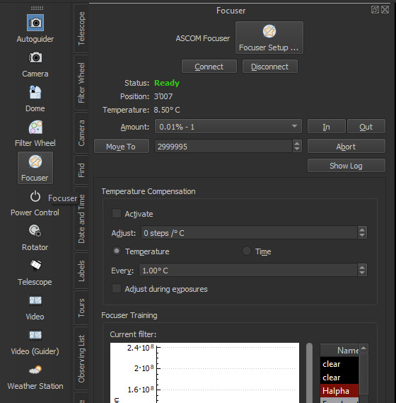
17. Check that the Filter wheel and Focuser are connected
1. Click on ‘Filter wheel’
2.Check that its status is ’Ready’
3. Click on ‘Focuser’
4.Check that its status is ’Ready’

Slide 16
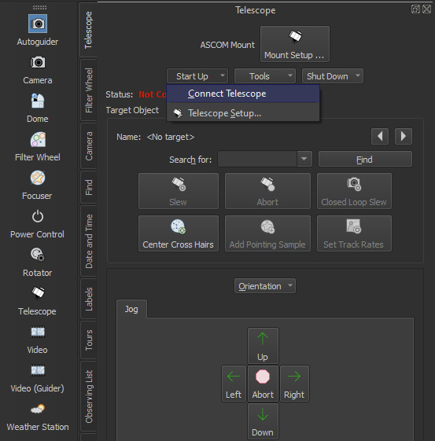
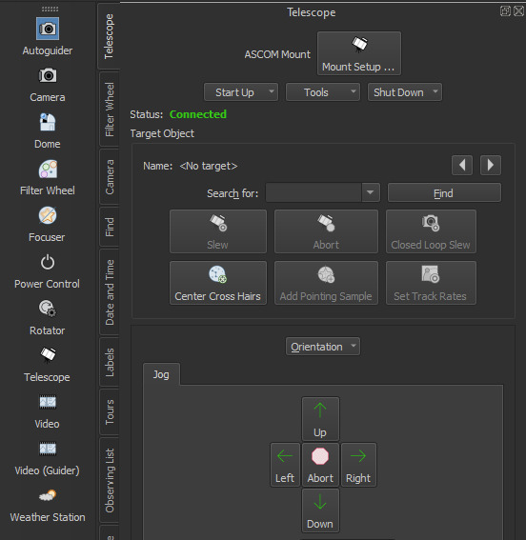
18. Connect the telescope
1. Click on ‘Telescope’
2. Click on ‘Start Up’
3. Select ’Connect Telescope’
4. All good!

Slide 17
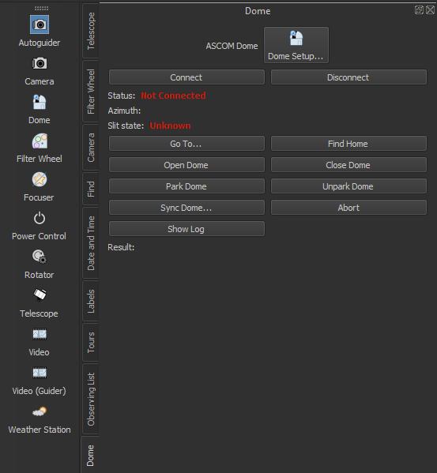
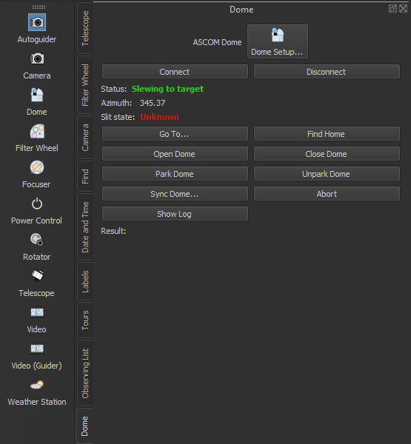
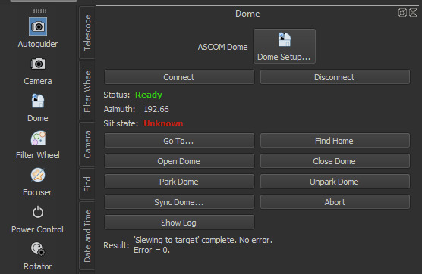
19. Connect the dome and find home position
1. Click on ‘Dome’
2. Click on ‘Connect’
3. The Dome is moving (you can hear it!)
4. Wait unti you see the Status: ‘Ready’
5. Click on ‘Find Home’
6. When you click on ‘Find Home’, the Dome will make one full turn to calibrate the spatial coordinates and then it will go in front of the telescope aperture. Be patient and wait.

Slide 18
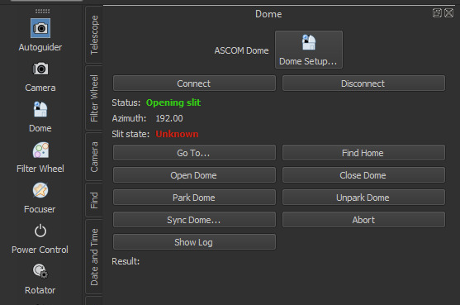
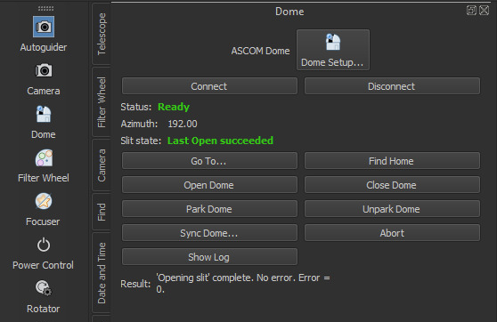
20. Open the dome
1. You should already be in the ‘Dome’ section
2. Click on ‘Open Dome’
3. The dome is opening
4. All good!

Slide 19
END STARTUP

Slide 20
OBSERVATIONS

Slide 21
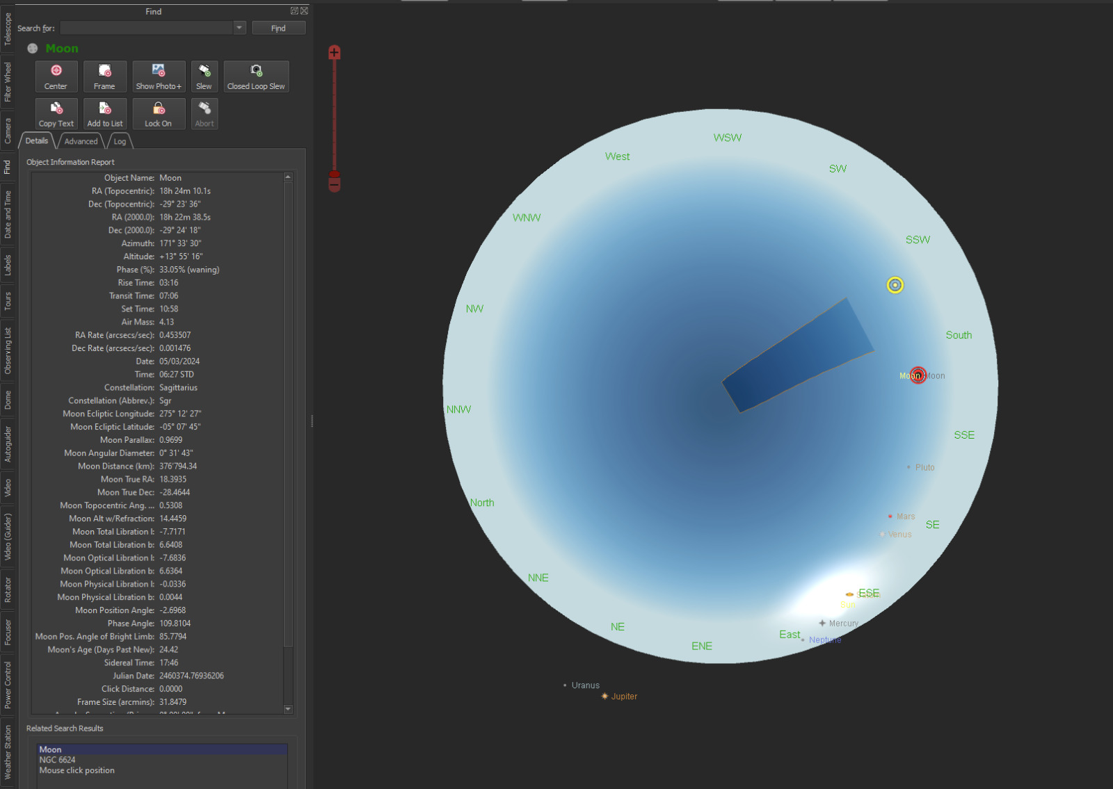
GENERAL INFORMATION
The yellow circle indicates where the telescope is pointing at (telescope direction)
The trapezoid shape indicates where the Dome is (it should be always on top or in front of the yellow point)
The red circle indicates where you clicked
When you click on a point on the sky (red circle), all the information of the target will appear here on the left

Slide 22
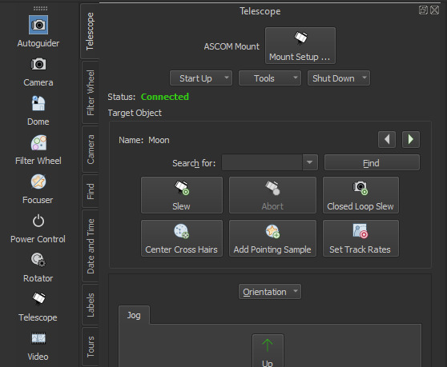
SELCTING A TARGET
You can select a target in two ways: by clicking on the sky map or by specifying the target name
1. Click the target on Sky map (e.g. Moon)
1. Click on ‘Telescope’
2. Write the name of the target you are looking for
3. Click on ‘Find’
OR

Slide 23
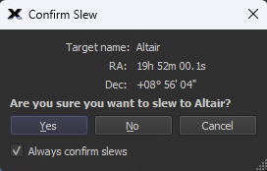
POINTING THE TELESCOPE ON YOUR TARGET
Once you found the target you want to observe, click on ‘Slew’ to move the telescope and Dome towards the target.
1. Check that the red circle is on top of the target you want to observe
2. Go in the ‘Telescope’ tab
3. Click on ‘Slew’
4. A window like this should appear. Click on ‘Yes’ to confirm the slew of telescope + dome towards your target

Slide 24
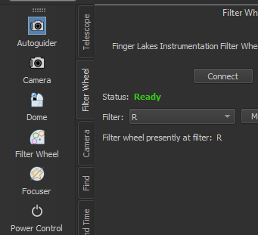
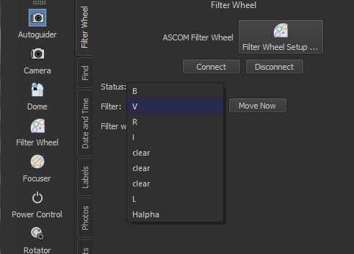
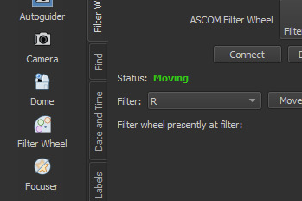
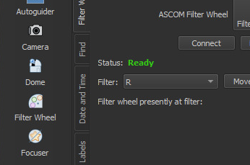
SELECTING THE FILTER
3. Select the filter you want to use from the list
4. Click on ‘Move Now’
1. Go in the ‘Filter Wheel’ tab
2. Click on the Filter window
5. Wait
6. All good

Slide 25
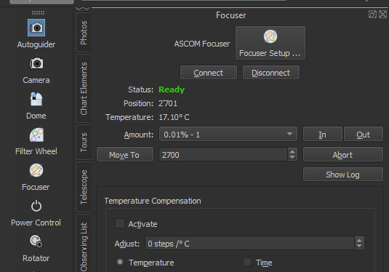
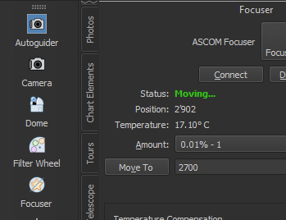
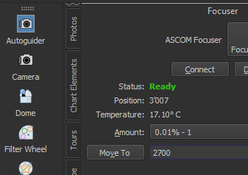
SELECTING THE FOCUSER (WE SUGGEST 5300)
2. This is the current position of your focuser
3. Insert here the number you want (5300 is good)
4. Click on ‘Move To’
5. Wait
6. All good
1. Go in the ‘Focuser’ tab

Slide 26
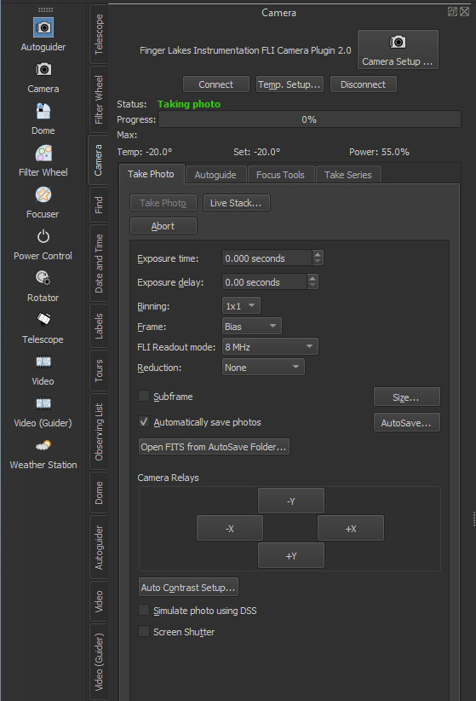
SELECTING PICTURE PROPERTIES
1. Go in the ‘Camera’ tab
2. Choose all the properties that you want:
- EXPOSURE TIME: time of the frame exposure
- EXPOSURE DELAY: time of delay between one picture and the following one
- BINNING: type of binning when pixels are read (lower binning is more precise, but takes longer time).
We suggest either 2x2 or 3x3 binning
- FRAME: select the frame you want to take. There is BIAS, DARK, FLAT FIELD, and LIGHT. LIGHT is the scientific image (your star, planet, galaxy etc.)
- FLI READOUT MODE: it’s the speed to read the CCD. For higher modes (8 MHz), the measurement is less precise, but the reading is faster
- REDUCTION: you can select if you want the program to perform the frame correction for you. We strongly suggest to do it yourself and just leave NONE

Slide 27
TAKING A SINGLE PICTURE
Once you chose all the picture properties (previous slide) and you point at the target you want to observe, you can take a picture by simply clicking on ‘Take Photo’. When the picture is done it will open automatically in front of you.

Slide 28

TAKING A SERIES OF PICTURES
There is the option to take multiple consecutive pictures
1. Go in the ‘Camera’ tab
5. Start to take the serie
2. Click on ‘Take Series’
3. Choose your settings (same settings as for the single picture)
4. Choose how many pictures you want to take

Slide 29




DATA STORAGE
Data (pictures) are automatically saved in a folder as fits files. To find them follow these procedures:
1. Select the folder icon in the bottom bar of the screen
2. Click on ‘This PC’
3. Select ‘Telesto_Data_Strage’
2. Select the ‘data’ folder
3. Your data are stored in the folder of your observing date.
For example, the folder 20240304 will contain images taken on the 4th of March 2024

Slide 30
END OF THE NIGHT

Slide 31



IN THE CONTROL ROOM
1. Park the telescope
1. Click on ‘Telescope’
2. Click on ‘Shut Down’
3. Choose ‘Park’
4. The telescope is parking
5. The telescope is parked

Slide 32

2. Disconnect the telescope
1. You should already be in the ‘Telescope’ tab
2. Click on ‘Shut Down’
3. Choose ‘Disconnect Telescope’
4. All good!

Slide 33



3. Close the dome
1. Go in the ‘Dome’ section
2. Click on ‘Close Dome’
3. The dome is closing
4. All good!

Slide 34

4. Park the dome
1. You should already be in the ‘Dome’ section
2. Click on ‘Park Dome’
3. All good!

Slide 35

5. Disconnect the dome
1. You should already be in the ‘Dome’ section
2. Click on ‘Disconnect’
3. All good!

Slide 36

6. Close SkyX and Maestro
Maestro icon
SkyX icon
Close it
Close it

Slide 37



7. Shut down the computer
Click on’Shut down’
Click on the switching off button
Select the Windows icon in the bottom bar of the screen

Slide 38


IN THE DOME
1. Verify by eye that everything is fine:
- Check that the dome is closed
- Check that the telescope and the dome are parked. A corrected parking position is shown in the pictures below. The dome aperture is above the ELT poster. The telescope is facing the ladder.
Seen from the entrance
Seen in front of the telescope

Slide 39
2. Turn off the Camera and the telescope: push up the two switches

Slide 40
3. Switch OFF the telescope electricity by using the designated switch (1=ON, 0=OFF).

Slide 41
4. Put back the cover on top of the telescope aperture (using the ladder)
With cover
Without cover
5. Be sure all lights in the building are switched off (Dome, Telesto control room, and stairs)

Slide 42
HAVE SWEET DREAMS

